Slide 1
Video processing I
Rivera, mib
Physics 301 wfz

Slide 2
objectives
Learn how to use a webcam for live image acquisition
Learn how to use face detection
Learn how to track objects using color segmentation

Slide 3

Video as a series of frames
Videos can be considered as images when we work with “frames”
We trick our eyes by placing frames of images successively, usually at a rate of 60 frames per second (which masks the succession of frames)
Even the gif on the right can be considered video since it displays motion.

Slide 4
methods
We use the “Matlab Support Package for USB Webcams” to enable video recognition through the built-in webcam of our laptop
We try the coding examples from Ramnarayan Krishnamurthy which explore motion detection from videos.
We apply color segmentation techniques from Activity 1 to create trackers for our object.

Slide 5
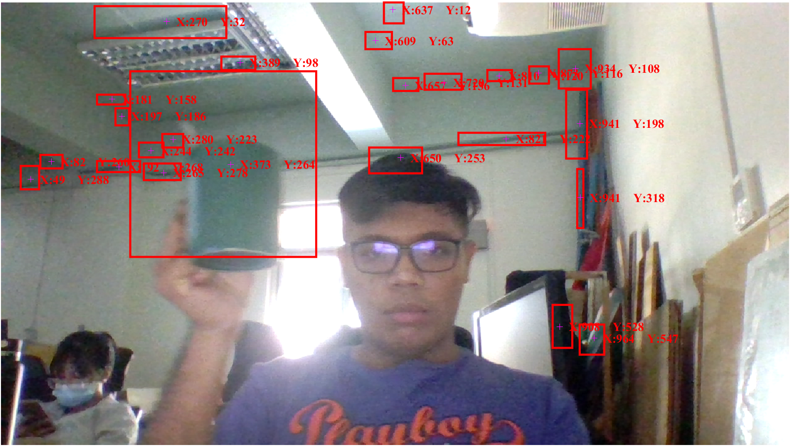
Image acquisition via webcam
By enabling the webcam, we can take a snapshot using the command “webcam.snapshot”
We can then apply the Computer Vision package “vision” to enable blob analysis and HUDs/overlays

Slide 6
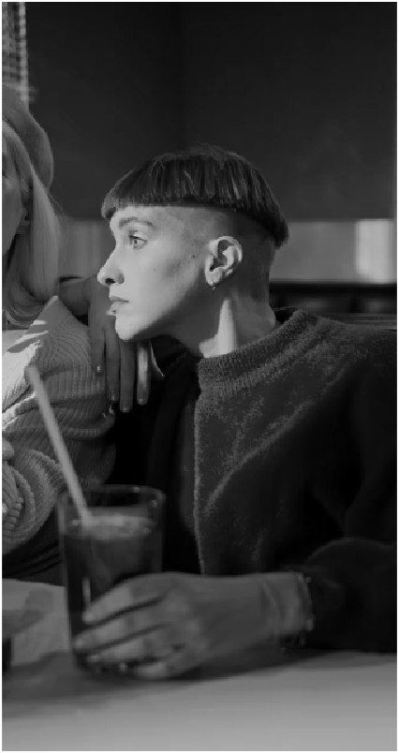
Image acquisition via preloaded videos
We can take a snapshot from preloaded videos by enabling MATLAB’s “VideoReader” function and taking a frame via the method “ReadFrame”.
We can then employ image processing techniques to these individual frames, e.g. “rgb2gray”
All prerecorded videos obtained for free from Pexels; screenshot above taken from cottonbro and edited via MATLAB

Slide 7
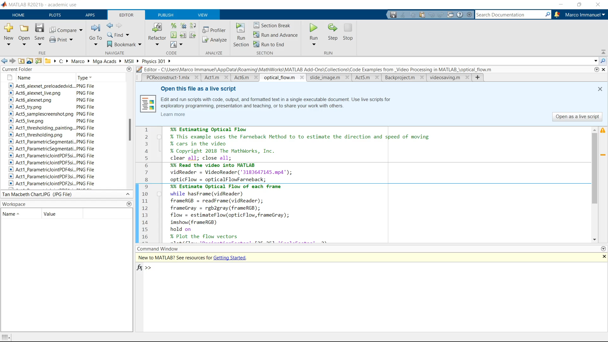
Optical flow
Optical flow shows how the motion of each individual element in the video can be predicted using vectors
Analogous to color and spectra, optical flow can be considered a combination of the motion between the observer (in this case, the camera) and the scene.
Code Examples from "Video Processing in MATLAB" - File Exchange - MATLAB Central (mathworks.com)

Slide 8
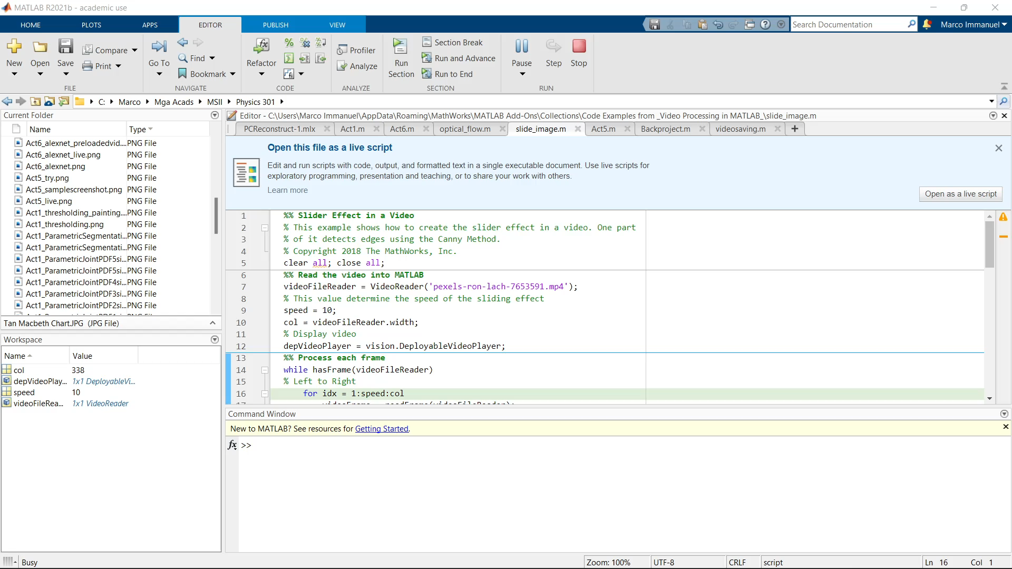
Face and line detection
MATLAB allows us to detect 3D by looking for similar characteristics within one frame
Code Examples from "Video Processing in MATLAB" - File Exchange - MATLAB Central (mathworks.com)

Slide 9
Detecting color in video

Slide 10
Recall: histogram backprojection
Non-parametric color segmentation method
Allows for a quick lookup of histogram values per pixel without calculating anything

Slide 11
Color tracking in video
We first get a screenshot from the live/prerecorded video so that we can get a region of interest.
Then, we loop over the frames of the video so that we can track the color. The loop goes like this:
For each snapshot, we return the result of the Histogram Backprojection technique so that we get the ROI for each frame
We then binarize the image and clean the result of the backprojection so that there are no lone pixels wandering about
We use MATLAB’s blob analysis via “regionprops” so we can contain the ROI in a rectangle

Slide 12
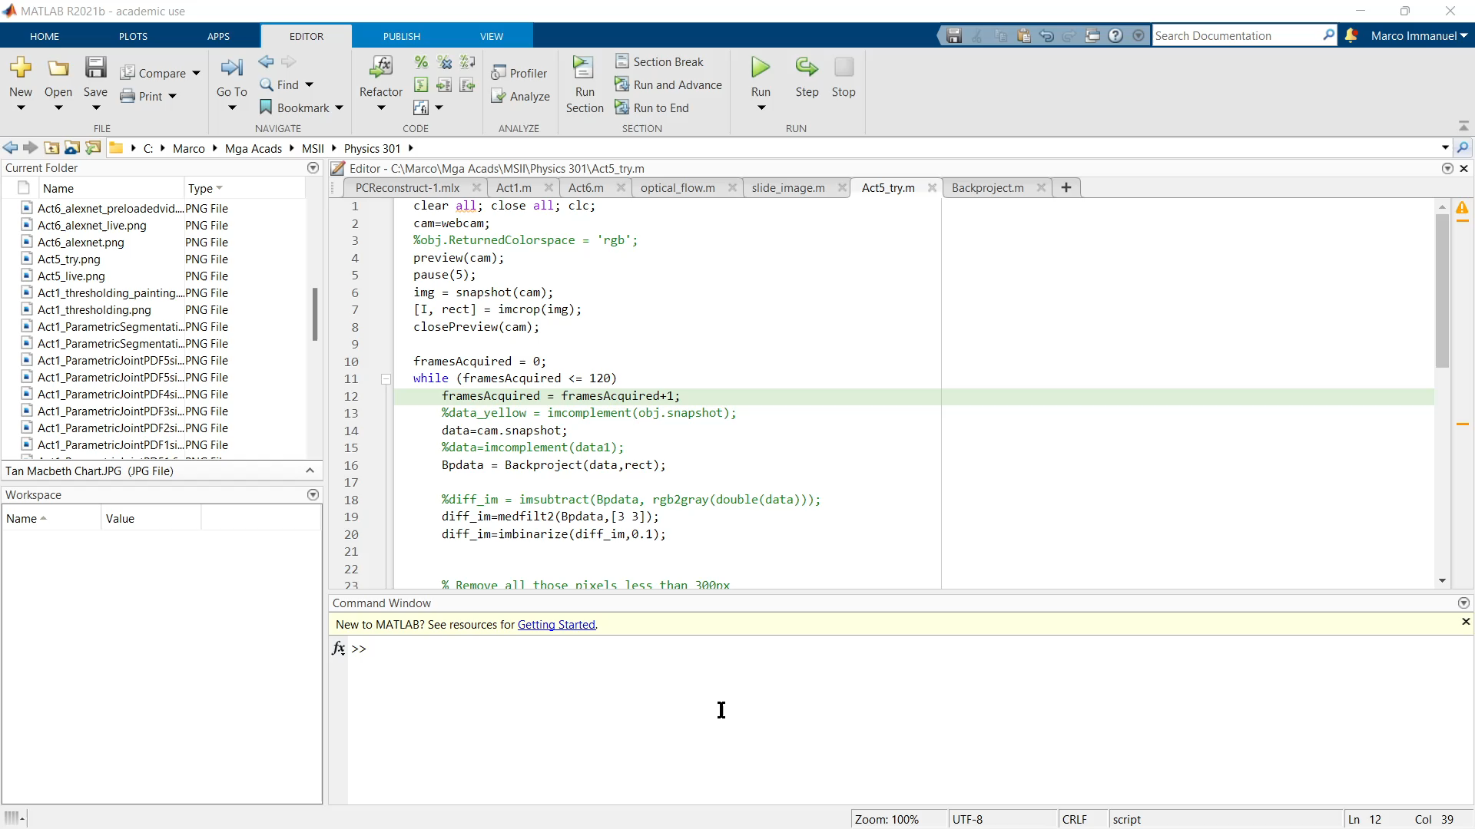
Color tracking in live video: Result

Slide 13
Reflection and self-grade
The code for this activity can be found at this GitHub page.
The errors shown in this activity is a reflection of the limitation of color as a characteristic of the object. I did enjoy the idea that you can quantify this error, but since the time is limited, I was not able to get the light source and camera that produces the least difference from the Macbeth patch.
Thus, I grade myself 80% for this activity; if only I have more time, I would certainly enjoy calculating the errors myself.

